Slide 1
Chat Robot

Slide 2
Table of Contents
Project Goals
Expected Results
Project Requirements

Slide 3
Project Goals

Slide 4
Project Goals
Design a real-time and intelligent text Chat-Bot on https://embedded.cs.ccu.edu.tw/center/#/
Target audience: Taiwanese and Indian projects seekers
Main purpose:
This is a platform for matching talents from Taiwan and India
Users look for projects on the platform
Users can explain their requirements for seeking their wanted project such as types, salary, project duration, etc.

Slide 5
Expected Result

Slide 6
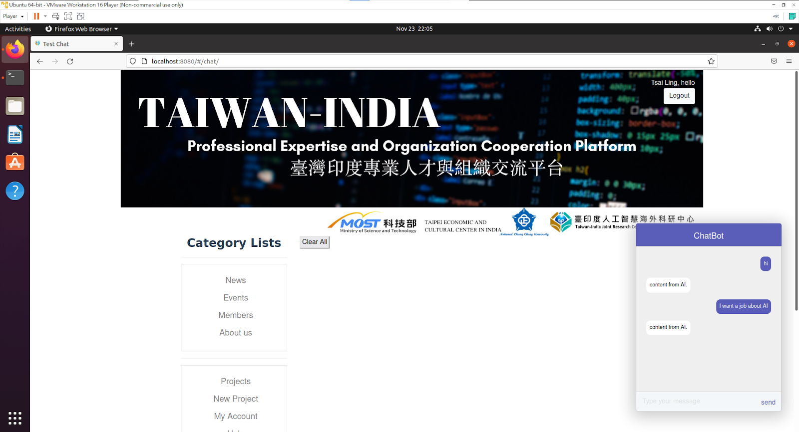
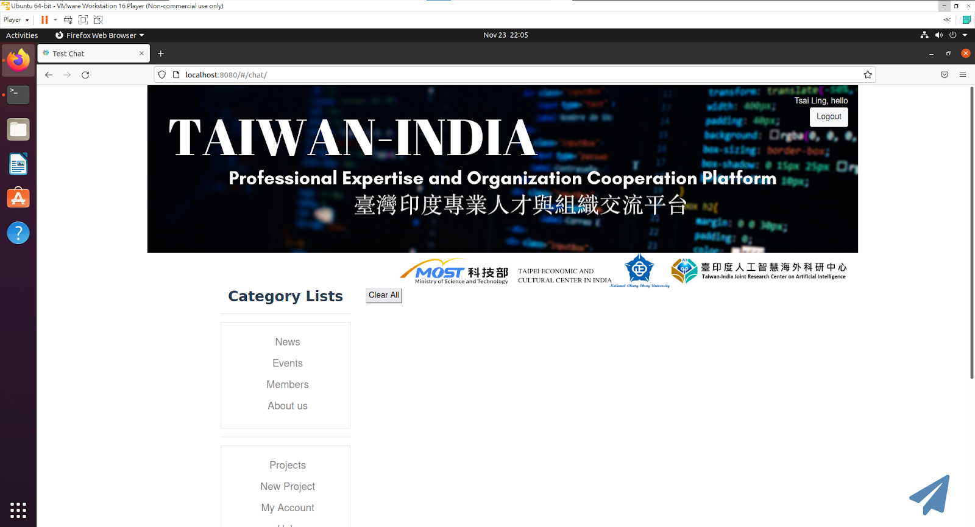

Slide 7
Bot
Hi
Hi! How may I help you
I want to find a project
Ok! Which project type would you like
Related to AI and IOT
Any conditions else?
Salary
Project duration.
No
Here are your searching results:
https://xxxx
send

Slide 8
Project Requirements

Slide 9
Requirements
User request analysis
Identify the user intent
Extract relevant keywords
Returning the response
Real-time response
The answer can be briefly divided into:
A generic predefined text (e.g. Hi, Thank you, etc.)
Data stored in backend (e.g. Find projects according to users’ requirements)

Slide 10
The Value of Implementation
Enhance customers experience
Improve customers engagement process
operational efficiency
Customers service at any time
Optimize cost
Automatic service replace traditional service agents

